Slide 1
Chapter 7
Logistic Regression
Classification

Slide 2
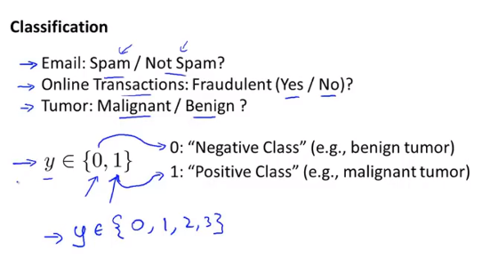
Chapter 7

Slide 3
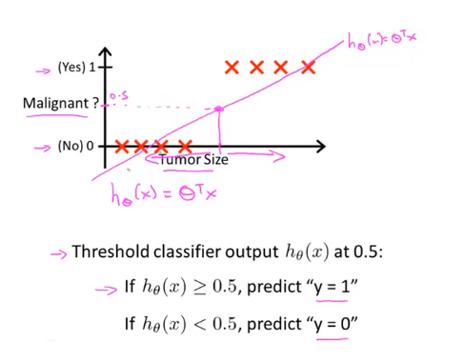
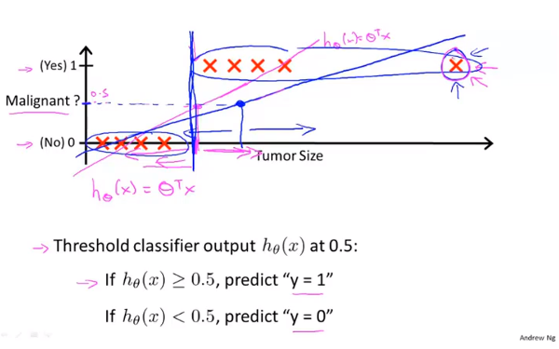
Chapter 7

Slide 4
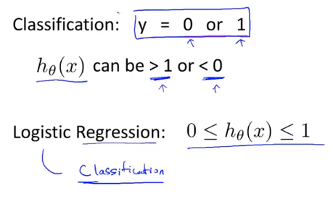
Chapter 7
Linear regression

Slide 5
Chapter 7
Logistic Regression
Hypothesis Representation

Slide 6
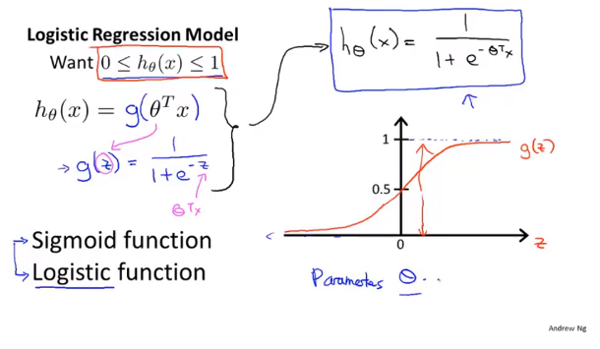
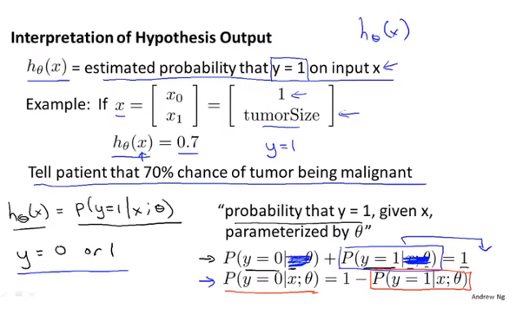
Chapter 7
Hypothesis representation for logistic regression

Slide 7
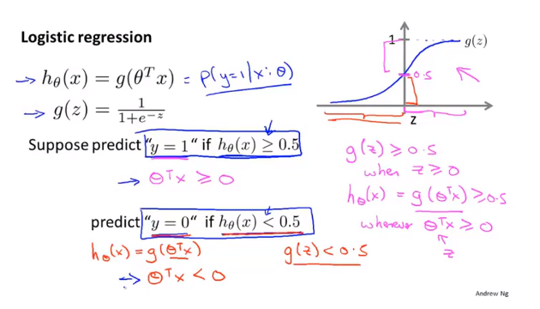
Chapter 7
Logistic Regression
Decision boundary

Slide 8
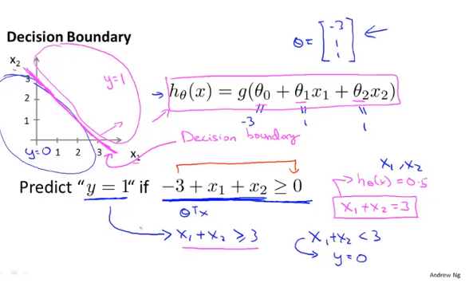
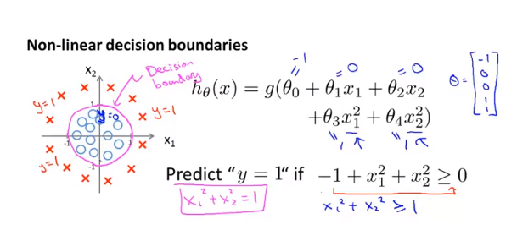
Chapter 7
The decision boundary is a property not of the training set, but of the hypothesis and of the parameters.
Training set is used to fit theta

Slide 9
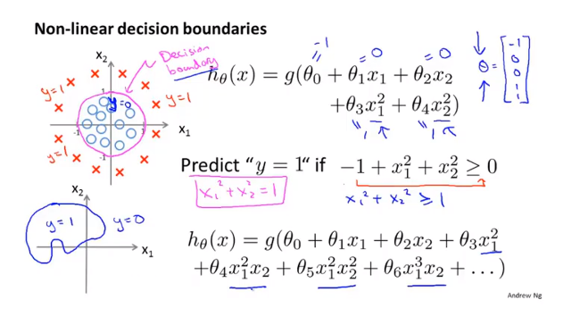
Chapter 7

Slide 10
Chapter 7
Logistic Regression
Cost function
Optimal objection or cost function we’ll used to fit the parameters.

Slide 11
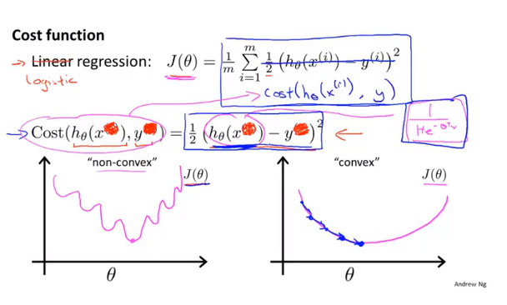
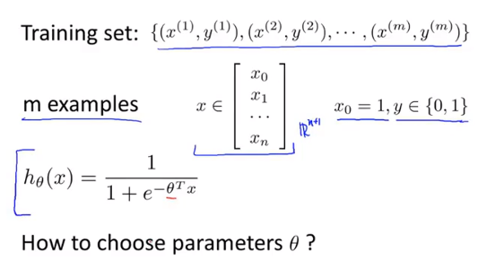
Chapter 7

Slide 12
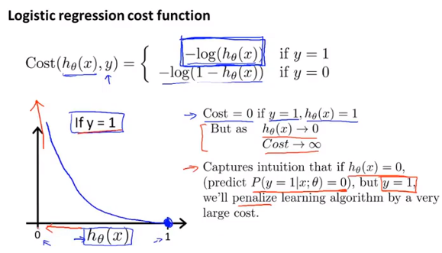
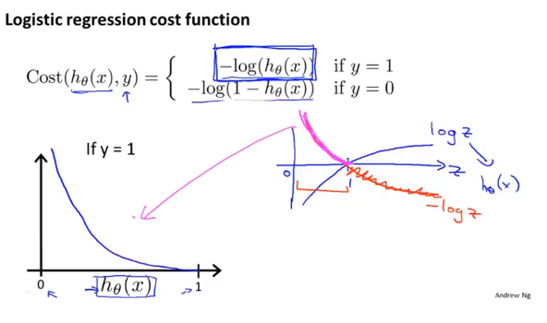
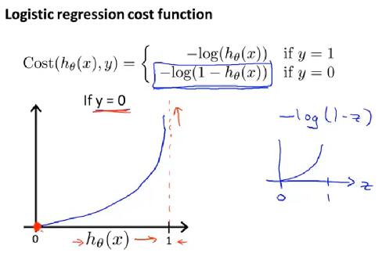
Chapter 7
Cost function we choose give us a convex
optimization problem
J(theta) is a convex and local optimal free

Slide 13
Chapter 7
Logistic Regression
Simplified cost function and gradient descent

Slide 14
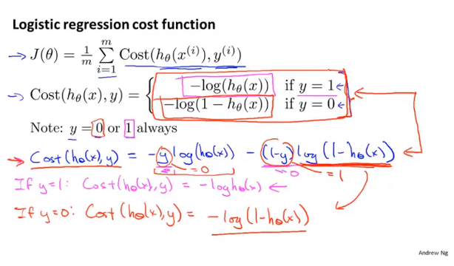
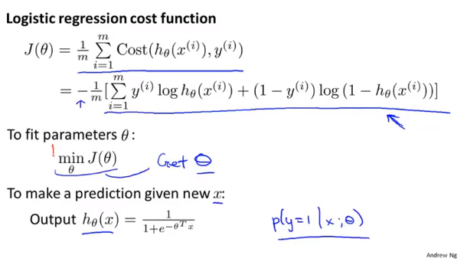
Chapter 7
This equation is derived from statistics using the principle of maximum likelihood estimation,
Which is an idea in statistics for how to efficiently find parameters theta for different models.
It is also has a nice property that it is convex.

Slide 15
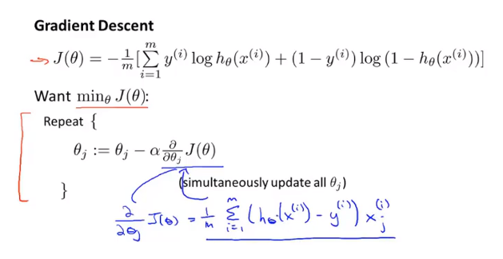
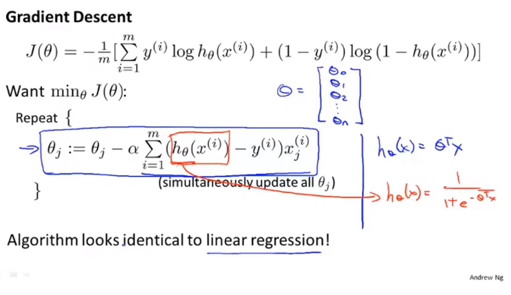
Chapter 7

Slide 16
Chapter 7
Logistic Regression
Advanced optimization

Slide 17
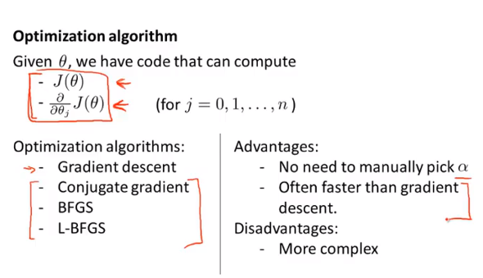
Chapter 7

Slide 18
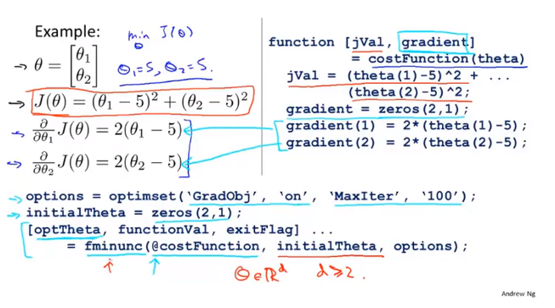
Chapter 7

Slide 19
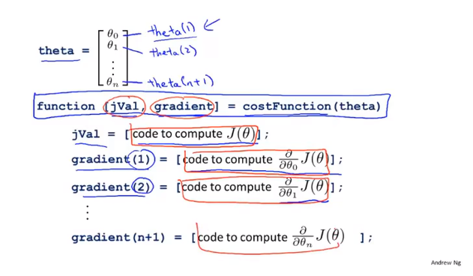
Chapter 7

Slide 20
Chapter 7
Logistic Regression
Multi-class classification
One-vs-all

Slide 21
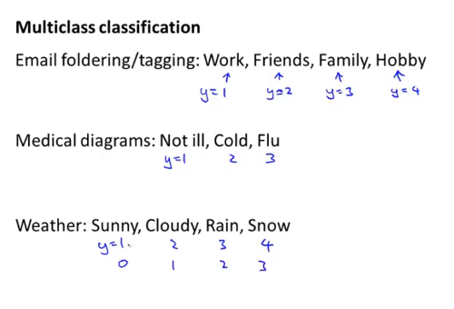
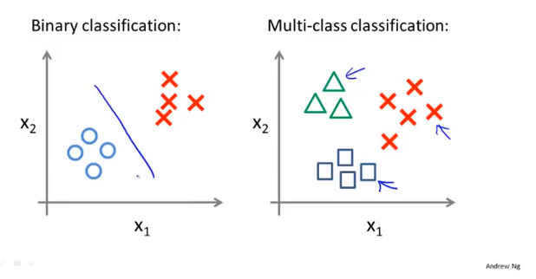
Chapter 7

Slide 22
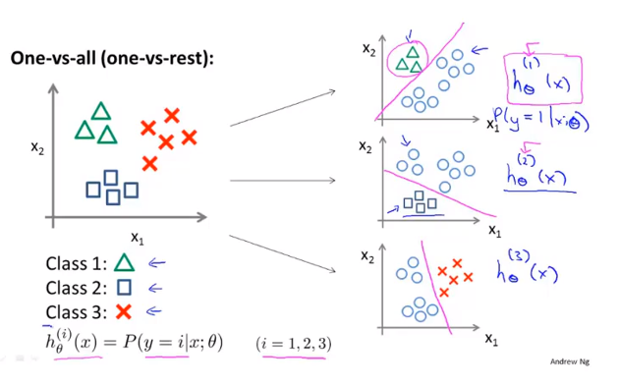
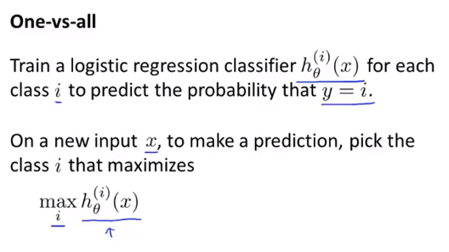
Chapter 7

